Slide 1
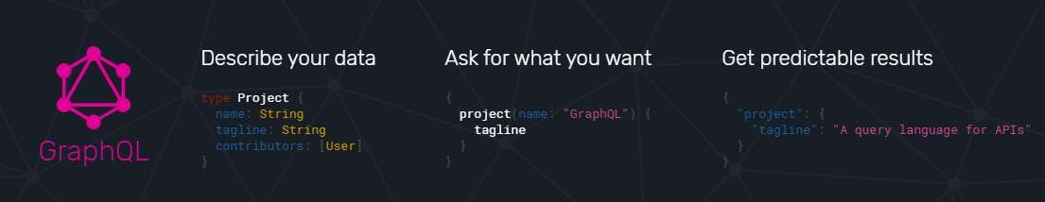

Slide 2
Think GraphQL

Slide 3
GraphQL in a nutshel
GraphQL is a syntax that describes how to ask for data, and is generally used to load data from a server to a client. GraphQL has three main characteristics:
It lets the client specify exactly what data it needs.
It makes it easier to aggregate data from multiple sources.
It uses a type system to describe data.

Slide 4












GraphQL Users

Slide 5
GraphQL History
GraphQL was developed internally by Facebook in 2012 before being publicly released in 2015. On 7 November 2018, the GraphQL project was moved from Facebook to the newly-established GraphQL foundation, hosted by the non-profit Linux Foundation.

Slide 6
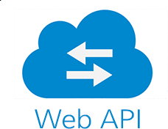

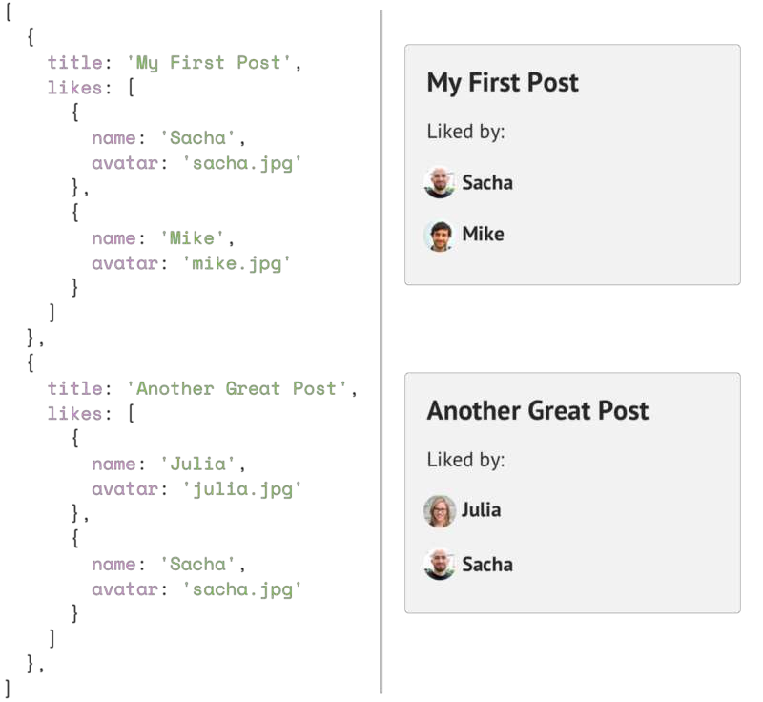
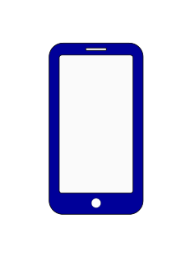

Background
Imagine you need to display a list of posts, and under each post a list of likes, including user names. Easy enough, you tweak your posts API to include a likes array containing user objects
Posts
Likes
Traditional REST APIs

Slide 7
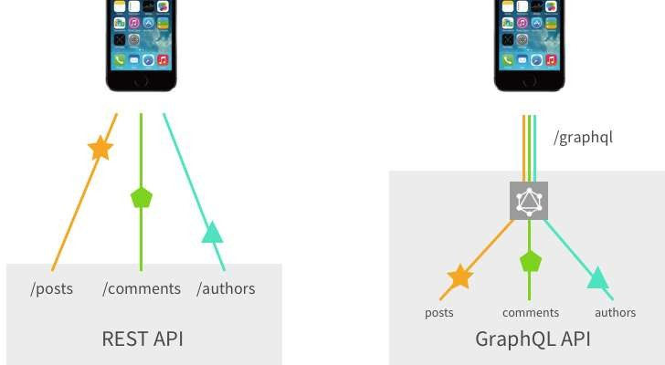
The Solution
Instead of having multiple “dumb” endpoints, have a single “smart” endpoint that can take in complex
queries, and then massage the data output into whatever shape the client requires.
The GraphQL layer lives between the client and one or more data sources, receiving client requests and fetching the necessary data according to your instructions.
The Client can retrieve the data it needs in a single round-trip to the API gateway.

Slide 8
GraphQL magic
A GraphQL schema is a strongly typed schema.
GraphQL speaks to the data as a Graph, and data is naturally a graph.
GraphQL has a declarative nature for expressing data requirements.
GraphQL solved the multiple round-trip problem.

Slide 10
Components
Query
A GraphQL query is the client application request to retrieve data from database or legacy API's. Resolver
Schema
A GraphQL schema is at the center of any GraphQL server implementation and describes the functionality available to the clients which connect to it.
Resolvers
provide the instructions for turning a GraphQL operation into data. They resolve the query to data by defining resolver functions.

Slide 11
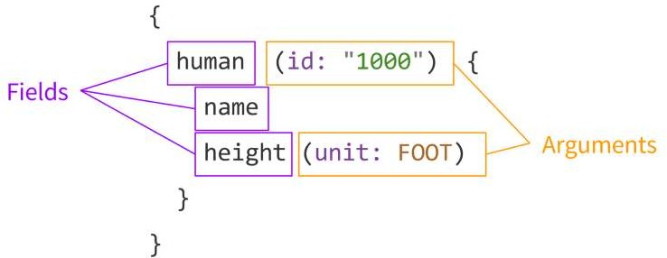
GraphQL queries
GraphQL document: A string written in the GraphQL language that defines one or more operations and fragments.
Operation: A single query, mutation, or subscription that can be interpreted by a GraphQL execution engine.
Field: A unit of data you are asking for, which ends up as a field in your JSON response data.
Arguments: A set of key-value pairs attached to a specific field. These are passed into the server-side
execution of this field, and affect how it’s resolved.

Slide 12
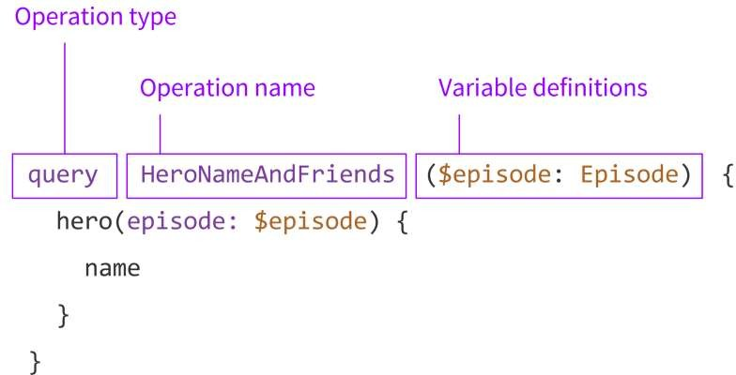
GraphQL queries Cont.
Operation type: This is either query, mutation, or subscription.
Operation name: For debugging and server-side logging reasons, it’s useful to give your queries meaningful
names.
Variable definitions: When you send a query to your GraphQL server, you might have some dynamic parts
that change between requests, while the actual query document stays the same. These are the variables of your query.
Variables: The dictionary of values passed along with a GraphQL operation, that provides dynamic parameters to that operation.

Slide 13
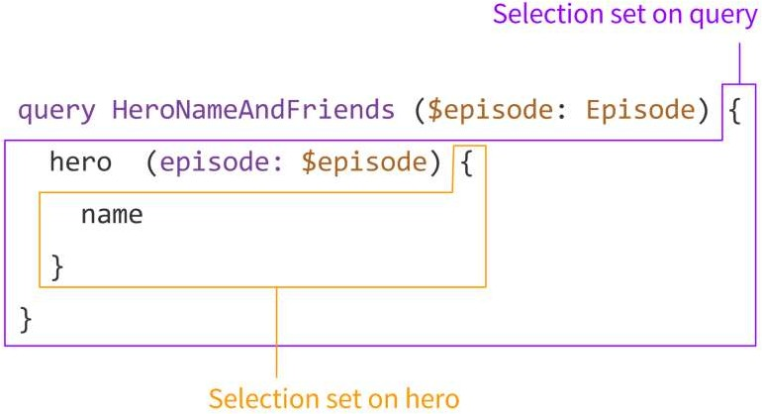
GraphQL queries Cont.
Selection set: A set of fields requested in an operation, or nested within another field. A GraphQL query must contain a selection set on any field that returns an object type, and selection sets are not allowed on fields that return scalar types, such as Int or String.

Slide 14
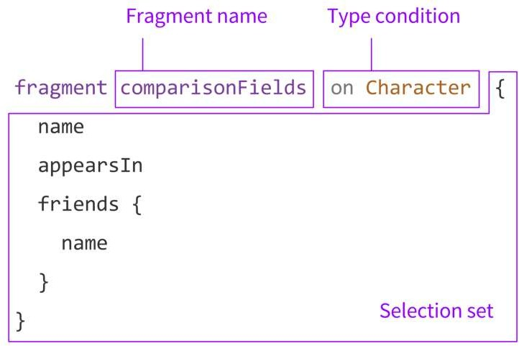
Fragments
Fragment definition: Part of a GraphQL document which defines a GraphQL fragment. This is also sometimes called a named fragment, in contrast to an inline fragment.
Fragment name: The name of each fragment has to be unique within a GraphQL document. This is the name you use to refer to the fragment in an operation or in other fragments.
Type condition: GraphQL operations always start at the query, mutation, or subscription type in your schema, but fragments can be used in any selection set.

Slide 15
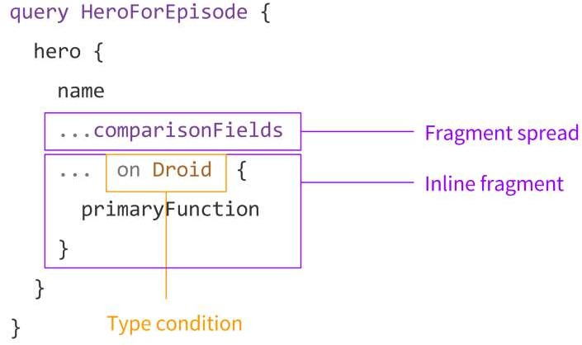
Fragments
Fragment spread: When you use a fragment inside an operation or another fragment, you do so by putting ... followed by the fragment name. This is called a fragment spread, and it can appear in any selection set that matches that named fragment’s type condition.
Inline fragment: When you just want to execute some fields depending on the type of a result, but you don’t
want to split that out into a separate definition, you can use an inline fragment.

Slide 16
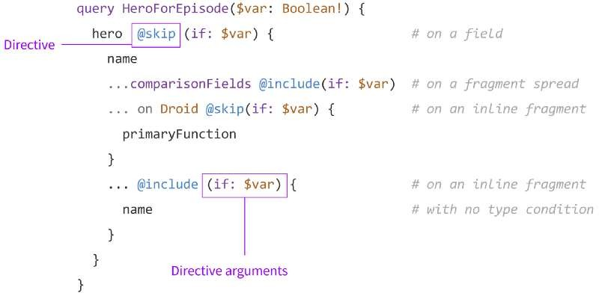
Directives
Directive: An annotation on a field, fragment, or operation that affects how it is executed or returned. Directive arguments: These work just like field arguments, but they are handled by the execution engine instead of being passed down to the field resolver.
@include(if: Boolean) Only include this field in the result if the argument is true. @skip(if: Boolean) Skip this field if the argument is true.

Slide 17
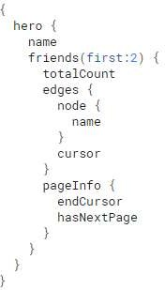
Pagination
There are a number of ways we could do pagination:
We could do something like friends(first:2 offset:2) to ask for the next two in the list.
We could do something like friends(first:2 after:$friendId), to ask for the next two after the last friend we fetched.
We could do something like friends(first:2 after:$friendCursor), where we get a cursor from the last item and use that to paginate.

Slide 18
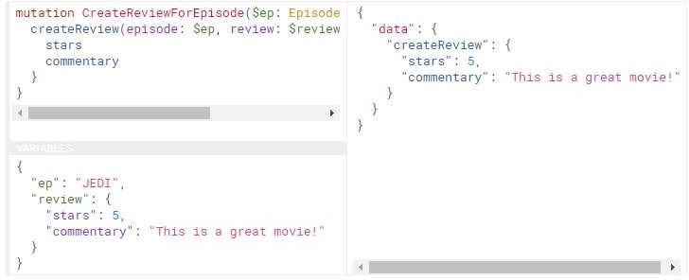
Mutation
Same as query behavior but aims to Insert-Update-Delete

Slide 19
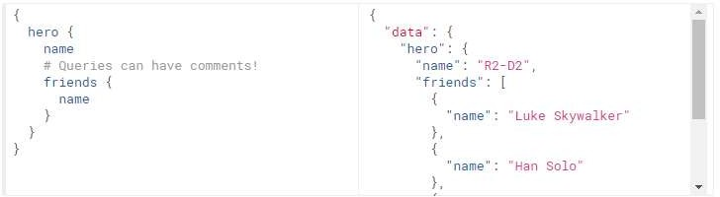
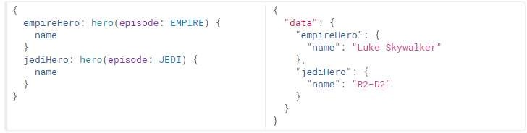
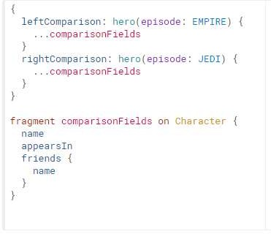
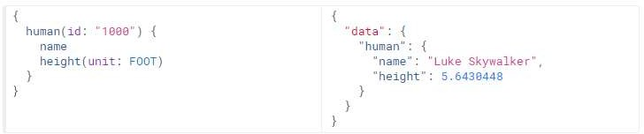
Samples
1-Sample Query
3-Aliace
2-Query with args
4-Fragments

Slide 20
Samples Cont.
4-Fragments
{
"data": { "leftComparison": {
"name": "Luke Skywalker",
"appearsIn": ["NEWHOPE", "EMPIRE", "JEDI"],
"friends": [ {"name": "Han Solo"}, {"name": "Leia Organa"}, {"name": "C-3PO"}, {"name": "R2-D2"}]},
"rightComparison": { "name": "R2-D2",
"appearsIn": ["NEWHOPE","EMPIRE","JEDI"],
"friends": [{"name": "Luke Skywalker"},{"name": "Han Solo"},
{"name": "Leia Organa"}]}
}
}

Slide 21
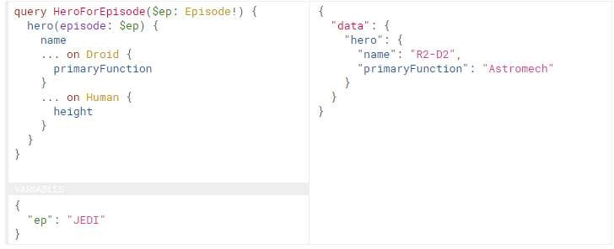
Samples Cont.
5-Inline Fragments

Slide 22
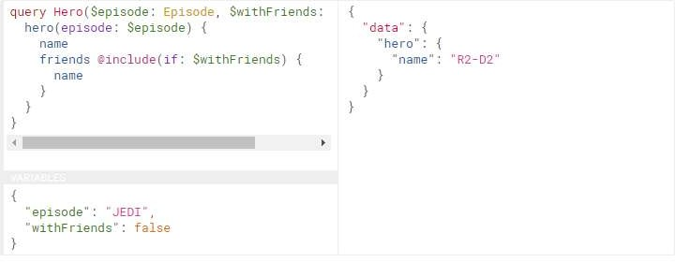
Samples Cont.
6-Directives

Slide 23
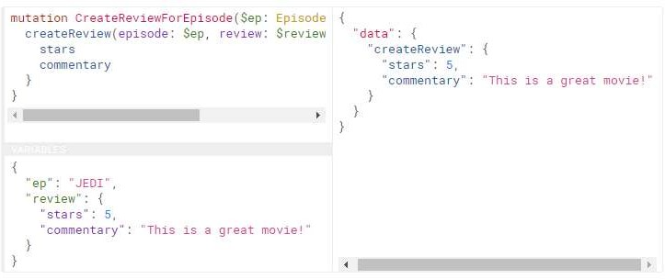
Samples Cont.
7-Mutation

Slide 24
GraphQL Schema
A GraphQL schema is at the center of any GraphQL server implementation and describes the functionality available to the clients which connect to it.
The core building block within a schema is the “type”. Types provide a wide-range of functionality within a schema, including the ability to:
Create relationships between types (e.g. between a Book and an Author).
Define which data-fetching (querying) and data-manipulation (mutating) operations can be executed by the client.
If desired, self-explain what capabilities are available to the client (via introspection).

Slide 25
GraphQL Schema Types
Scalar types
Scalar types represent the leaves of an operation and always resolve to concrete data. The default scalar types which GraphQL offers are:
Int: Signed 32‐bit integer
Float: Signed double-precision floating-point value
String: UTF‐8 character sequence
Boolean: true or false
ID (serialized as String): A unique identifier, often used to refetch an object or as the key for a cache. While
serialized as a String, ID signifies that it is not intended to be human‐readable

Slide 26
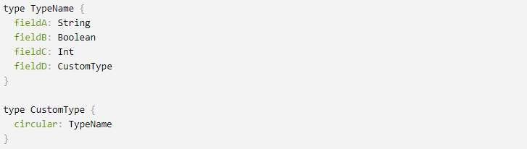
GraphQL Schema Types Cont.
Object types
The object type is the most common type used in a schema and represents a group of fields. Each field inside of an object type maps to another type, allowing nested types and circular references.

Slide 27

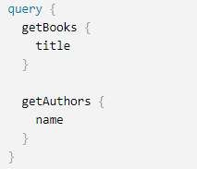
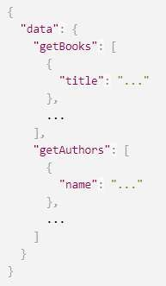
GraphQL Schema Types Cont.
The Query type
A GraphQL query is for fetching data and compares to the GET verb in REST-based APIs.
Schema
Response
Request

Slide 28

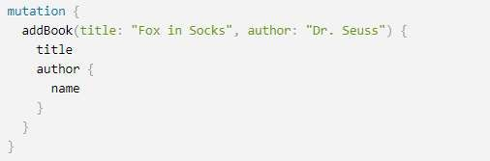
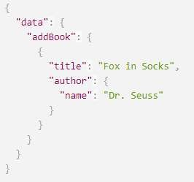
GraphQL Schema Types Cont.
The Mutation type
Mutations are operations sent to the server to create, update or delete data.
Schema
Request
Response

Slide 29
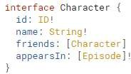
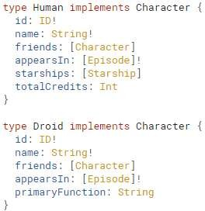
GraphQL Schema Types Cont.
The Interface type
An Interface is an abstract type that includes a certain set of fields that a type must include to implement the interface.

Slide 30
GraphQL Schema Types Cont.
The Subscriptions type
GraphQL subscriptions are a way to push data from the server to the clients that choose to listen to real time messages from the server. Subscriptions are similar to queries in that they specify a set of fields to be delivered to the client, but instead of immediately returning a single answer, a result is sent every time a particular event happens on the server.
why GraphQL is great for real-time apps:
Live-queries (subscriptions) are an implicit part of the GraphQL specification. Any GraphQL system has to have native real-time API capabilities.
A standard spec for real-time queries has consolidated community efforts around client-side tooling, resulting in a very intuitive way of integrating with GraphQL APIs.

Slide 31
GraphQL Advantages
Declarative Data Fetching
No Over fetching with GraphQL
Single Source of Truth
GraphQL embraces modern Trends
GraphQL Schema Stitching
GraphQL Introspection
Strongly Typed GraphQL
GraphQL Versioning
A growing GraphQL Ecosystem

Slide 32
GraphQL Disadvantages
GraphQL Query Complexity
GraphQL Caching
GraphQL security

